Slide 1

Student Data Analysis
Understand which habits affect student results and recommend changes to improve performance.

Slide 2
Aim & Research Questions
Identify which habits predict better exam results
Which features most influence exam score?
How do study hours, sleep, attendance and wellbeing relate to grades?
What practical recommendations can we give students and educators?
To use machine learning models to predict student performance and identify which features contribute most to success or failure
To evaluate how psychological and behavioral factors, such as mental health and social media usage, influence exam scores

Slide 3
Dataset & Cleaning
Rows: [1000] — Columns: study_hours_per_day, sleep_hours, attendance_percentage, exam_score, social_media_hours, netflix_hours, diet_quality, exercise_frequency, mental_health_rating, part_time_job, travel_time
Parent education column removed due to many missing values (91) and because wellbeing/psychology were prioritized
Cleaned file saved as students_clean.csv

Slide 4
Methodology
Exploratory Data Analysis (graphs & correlations)
Missing value handling, outlier removal (IQR), feature creation
Models: Logistic Regression, Random Forest, XGBoost (for prediction)
Explainability: SHAP / LIME (to find most important features)

Slide 5
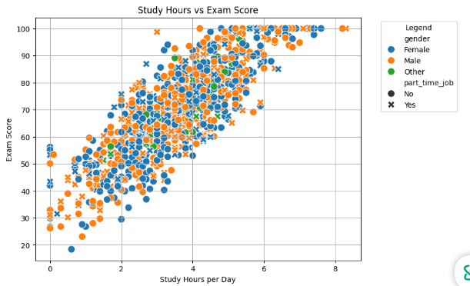
Scatter Plots: Exam Score vs Student Habits
We analysed study hours per day and exam scores to see how study habits affect performance. The graph shows that when study hours increase, exam scores also increase, which means there is a positive correlation and dependency between the two. This helps us spot trends, outliers, and understand that study hours are an important factor to consider before building machine learning models.

Slide 6
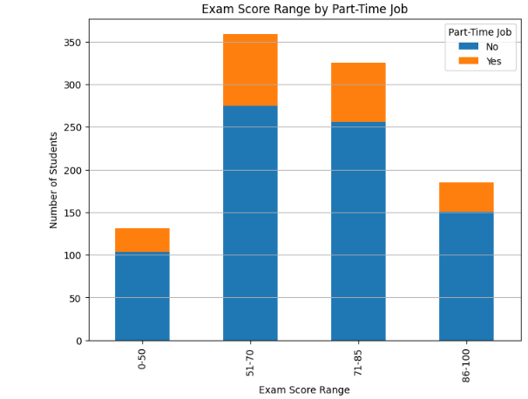
Exam Score Range by Part-Time Job Status
Students without part-time jobs generally achieve higher exam scores compared to those who work. This suggests that having a part-time job may negatively impact academic performance, likely because it reduces study time or increases stress. Supporting working students with time management or flexible study plans could help improve their results.

Slide 7
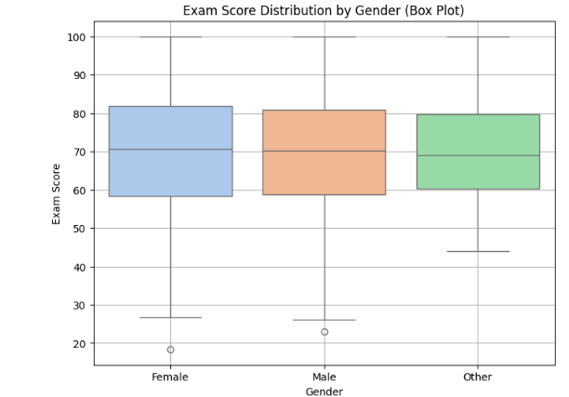
Exam Score Distribution by Gender
Both the box plot and violin plot show how exam scores differ between male and female students. The scores are mostly similar, but one gender may show slightly higher median scores or less score variation. This helps us understand if gender has any impact on academic performance. Since the ranges overlap a lot, it suggests that gender alone does not strongly affect exam results.

Slide 8
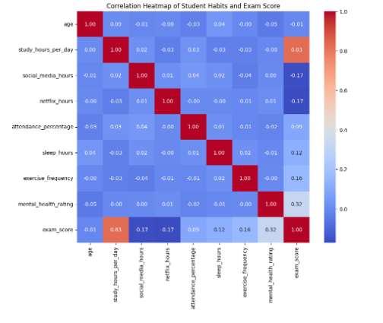
Correlation Between Student Habits and Exam Scores
This heatmap shows how different student habits are related to exam scores and to each other. Study hours and attendance have a strong positive relationship with exam scores meaning as they increase, exam scores also tend to increase. Social media and Netflix hours show a negative or weak relationship with performance. This helps to identify which habits support or harm academic success.

Slide 9
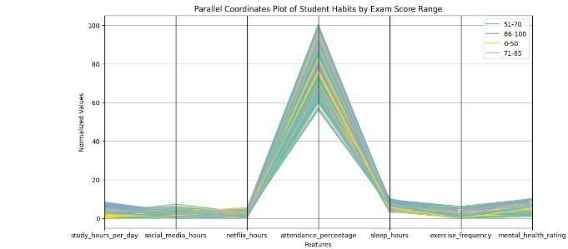
Parallel Coordinates Plot of Student Habits and Exam Score Ranges
This graph compares multiple student habits at the same time across different exam score ranges. Students with higher exam scores (71–100) tend to study more, attend classes regularly, sleep better, and have healthier mental and physical habits. Lower-performing students show more time on social media or Netflix and lower attendance. This helps us see how different habits work together and affect academic performance.

Slide 10
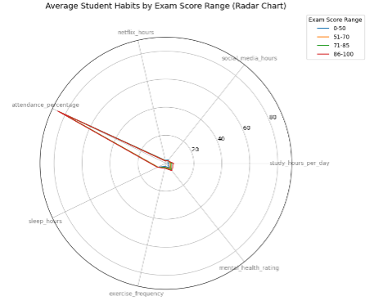
Average Student Habits by Exam Score Range
This radar chart shows how different student habits change across exam score ranges. Students who score higher (7 to 100) usually study more, attend classes regularly, sleep better, exercise more, and have better mental health. In contrast, students with lower scores tend to spend more time on social media or Netflix and have lower attendance and weaker study habits. This chart is important because it shows how multiple habits work together and how they affect academic performance.

Slide 11
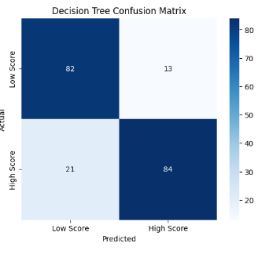
Decision Tree Classifier to Predicting Student Performance
The Decision Tree Classifier was used because it is simple to understand and shows which student habits affect exam scores the most. It splits the data based on important features like study hours, attendance, and sleep, to predict whether a student will score above 70 or not.
The model achieved 83% accuracy, meaning it predicts correctly most of the time. The confusion matrix and classification report show that it works well for both high and low-scoring students. This model helps us clearly see which habits lead to good academic performance and can guide schools or students in making better decisions.

Slide 12
Decision Tree Classifier – Predicting Student Performance
The Decision Tree Classifier was used because it is simple to understand and shows which student habits affect exam scores the most. It splits the data based on important features like study hours, attendance, and sleep, to predict whether a student will score above 70 or not.
The model achieved 83% accuracy, meaning it predicts correctly most of the time. The confusion matrix and classification report show that it works well for both high and low-scoring students. This model helps us clearly see which habits lead to good academic performance and can guide schools or students in making better decisions.

Slide 13
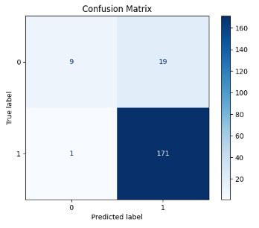
Confusion Matrix & Model Performance Summary
This confusion matrix shows how well the model predicts student performance (high vs low exam scores). It compares actual results with predicted results:
True Positives & True Negatives show correct predictions.
False Positives & False Negatives show where the model made mistakes.
The classification report provides precision, recall, and F1-score, which help us understand how accurate and reliable the model is. These metrics confirm whether the model is good at identifying both high-performing and low-performing students

Slide 14
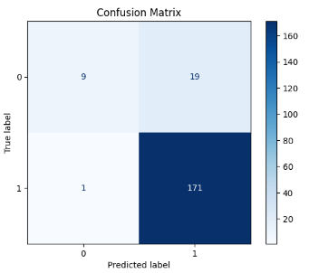
ROC Curve and AUC – Evaluating Model Performance
The ROC curve is used to evaluate how well the model can distinguish between students who pass and those who fail. It shows the balance between correctly predicting passing students and the mistakes made when failing students are predicted as pass. The Area Under the Curve (AUC) gives a single score that represents the model’s performance — a value close to 1 means the model predicts very well, while 0.5 means it is no better than random guessing

Slide 15
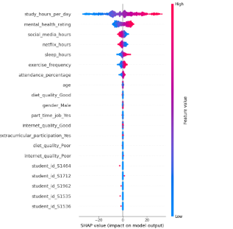
SHAP Analysis – Understanding Feature Impact on Exam Scores
The SHAP analysis helps explain which student habits have the biggest influence on exam scores in the prediction model. Instead of just showing which features are important, SHAP also tells us whether each feature increases or decreases the predicted score. For example, higher study hours and better attendance usually push the exam score higher, while excessive social media or Netflix hours may lower it.
This makes SHAP very useful because it is both accurate and easy to interpret. It gives a fair breakdown of each feature's contribution for every student also shows the most important features overall. This helps us clearly understand which habits matter the most and why they affect academic performance.

Slide 16
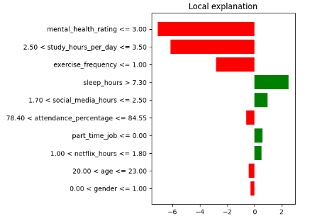
LIME Analysis – Explaining Individual Student Exam Predictions
In this analysis, a Random Forest Regressor was used to predict students’ exam scores based on various academic, personal, and lifestyle factors. After training the model, LIME (Local Interpretable Model-Agnostic Explanations) was applied to explain the prediction for a specific student from the test dataset.
LIME helps us understand which features contributed most to that individual student’s predicted score by showing positive and negative influences of each feature. This makes the model more transparent and ensures that its decision-making process is not a “black box.” The resulting plot clearly shows which student behaviors or conditions had the strongest impact, helping educators or decision-makers provide more personalized support.

Slide 17
Findings, Conclusion & Recommendations
The machine learning model (Random Forest) accurately predicts student exam scores.
Study habits, sleep duration, attendance, internet quality, and stress levels are the most impactful factors.
Explainable AI tools like SHAP and LIME made the model transparent and easy to understand.
Academic performance is not random — it is strongly influenced by lifestyle, learning patterns, and mental well-being.
AI and data analysis can help identify students at risk, support teachers, and improve academic strategies.
Students should maintain consistent study routines, enough sleep, and healthy habits.
Schools should improve support for learners by monitoring study patterns, stress levels, and internet access.
Future work can include larger datasets, more advanced models, or dashboards for real-time student performance monitoring.

